Slide 1

The Mighty Pythons
Evan Hudson, Todd Askren, Lee Laffitte, Mileah joy , kobe herrington.

Slide 2

Who are We

Slide 3

Group Project

Slide 4

MedReach Inc.
Non-profit Christian organization
Provides medical and spiritual support to African countries
Needs help in packing supplies and sorting inventory

Slide 5
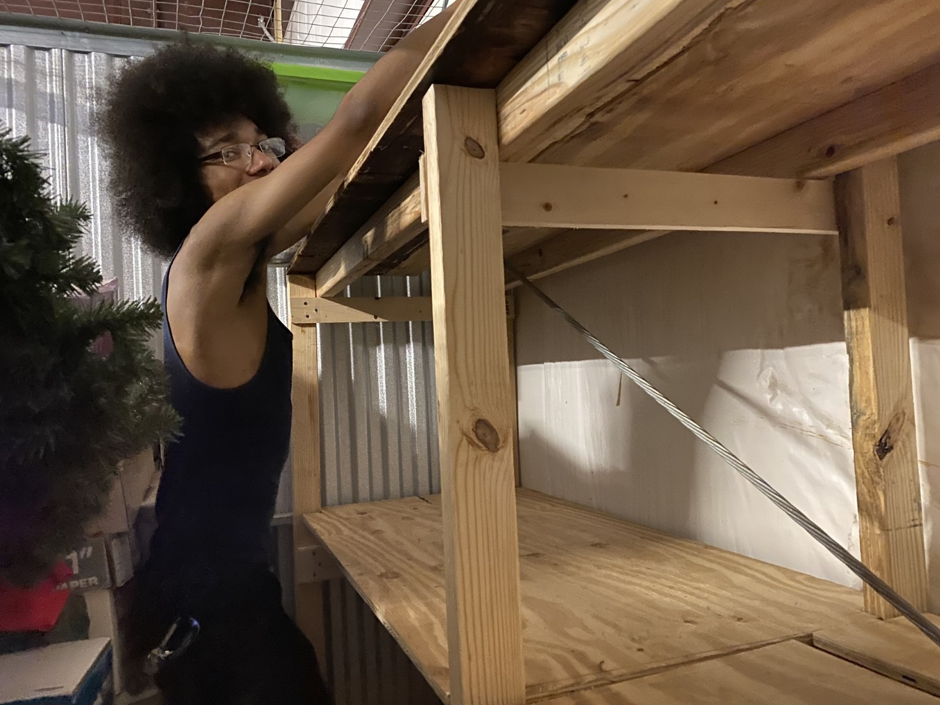
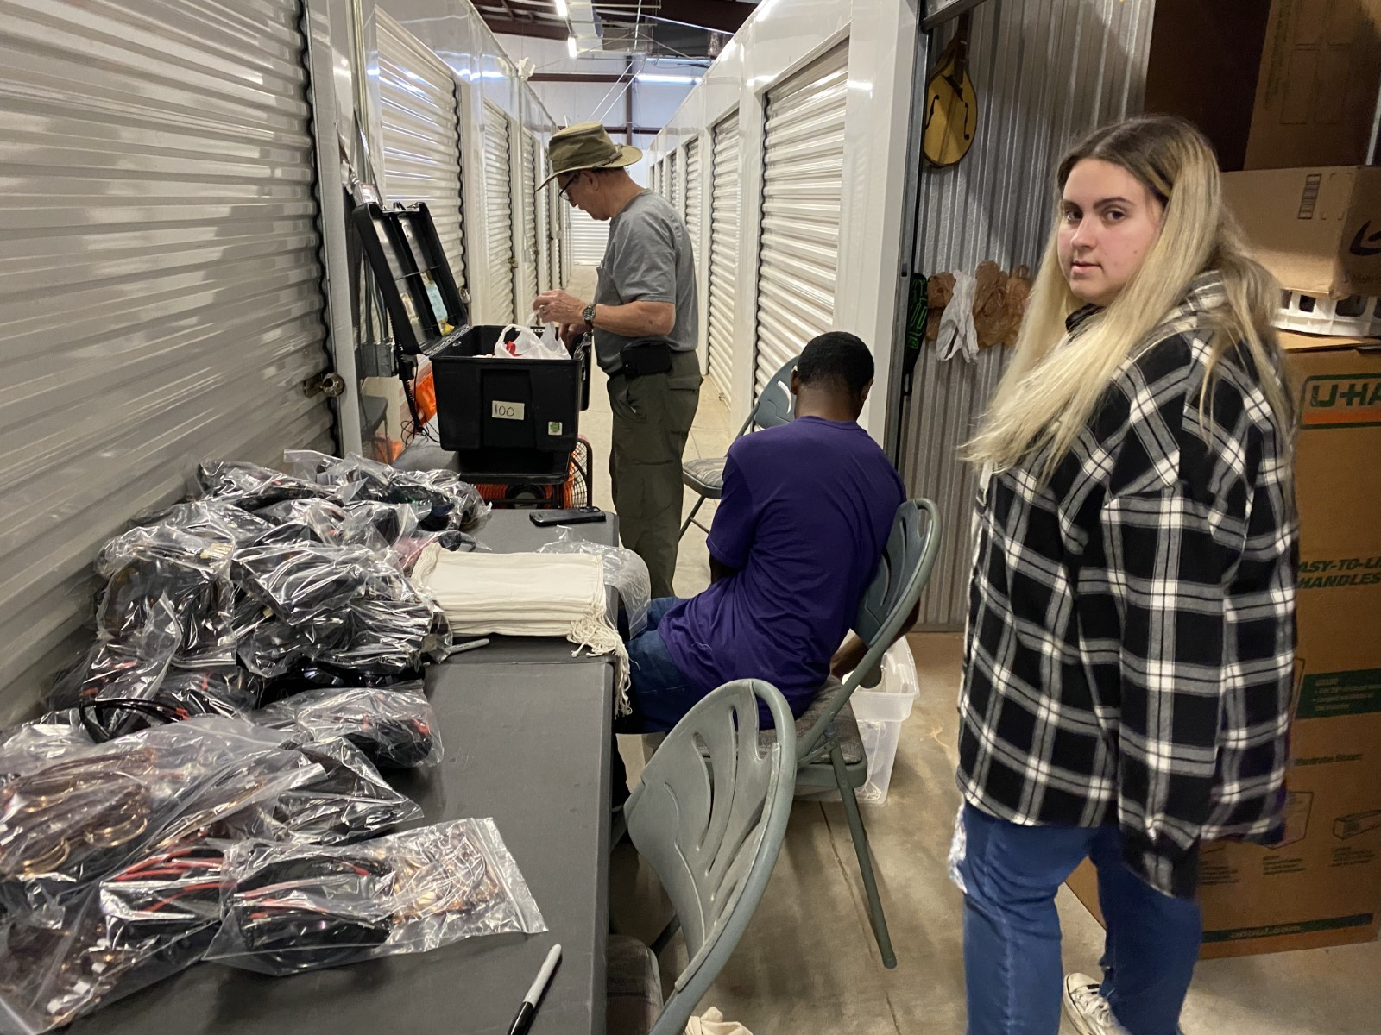
Volunteer/Assessment

Slide 6
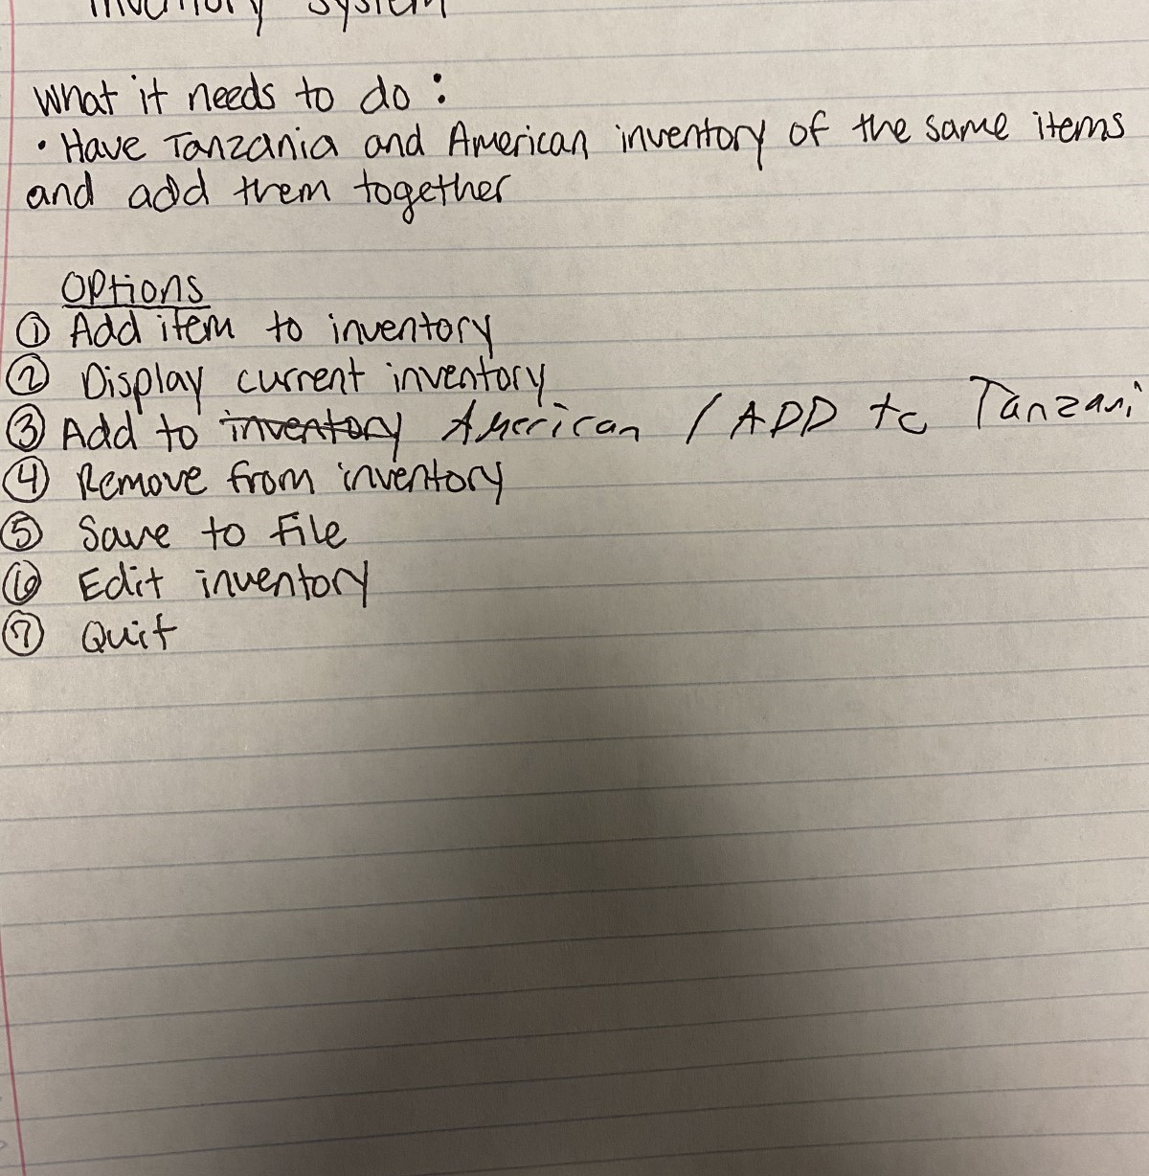
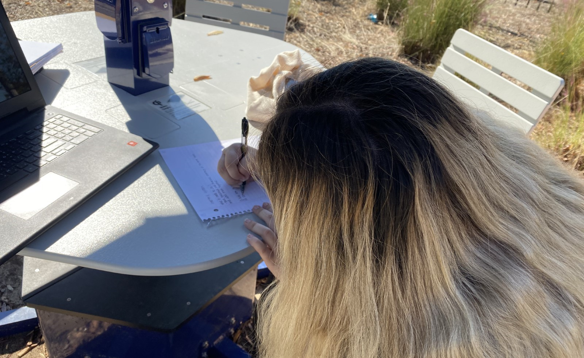
Brainstorm

Slide 7
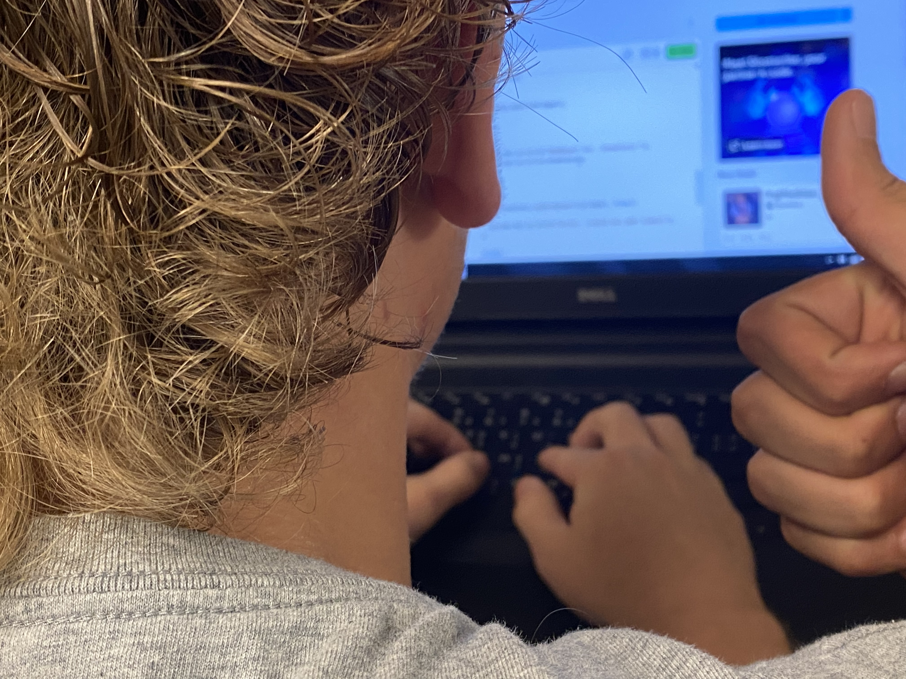
The Program
https://replit.com/@Deadpool123456/Inventory?v=1

Slide 8
Group dynamics

Slide 9

Concept 1:Interpersonal Needs
Manifested through inclusion
Manifested through control
Manifested through openness

Slide 10

Concept 2: Electronic Brainstorming
Manifested through GroupMe
Manifested through facetime

Slide 11
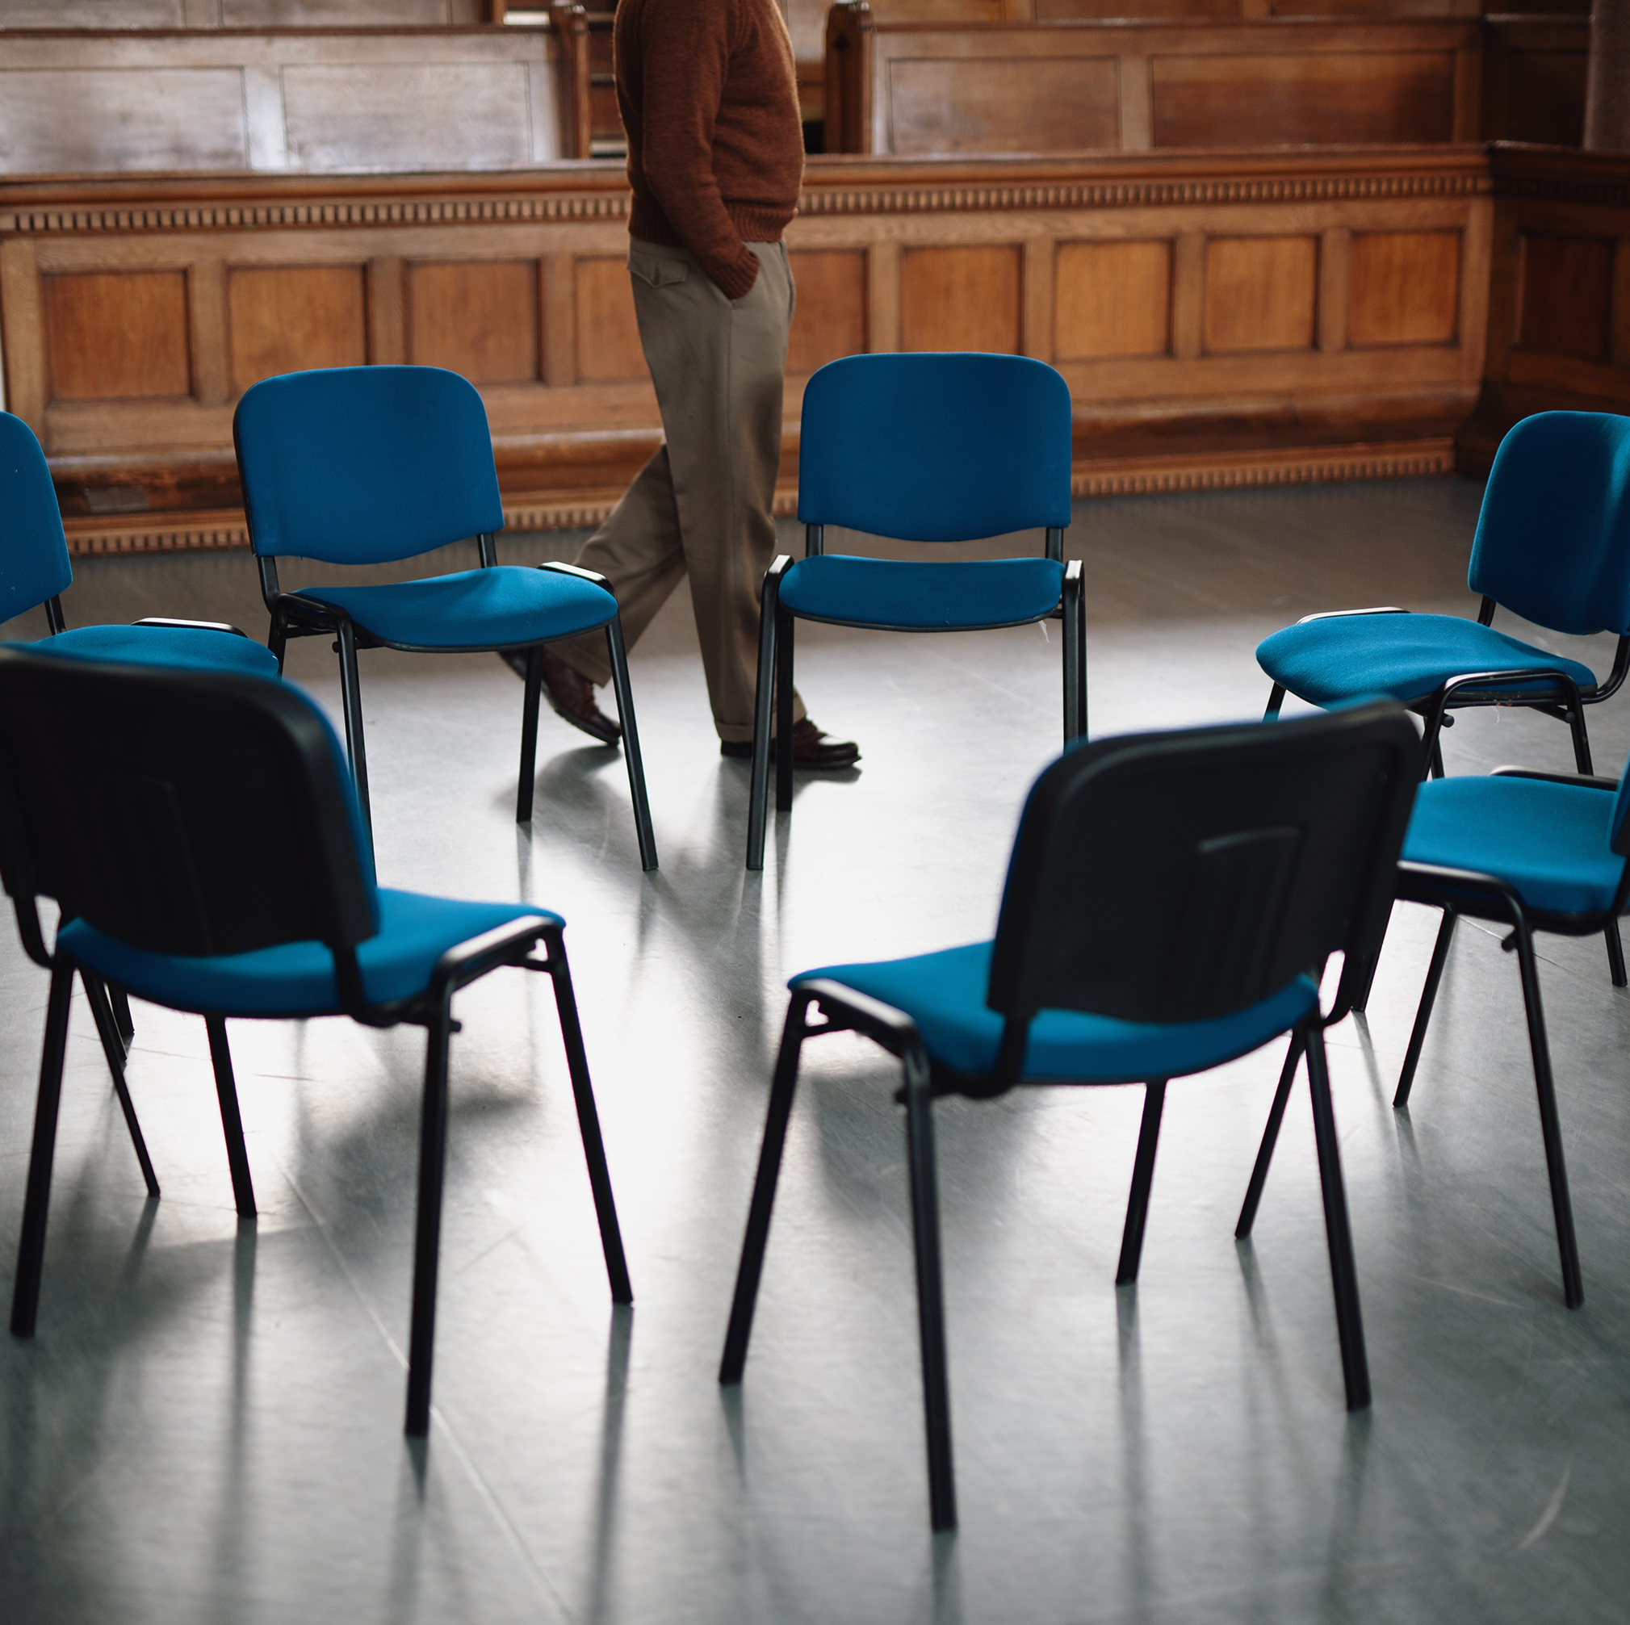
Concept 3: Structure
Manifested through seating
Manifested through task-oriented leadership
Manifested through schedule

Slide 12
General Systems Theory
Inputs- problem of inventory system and group members unique knowledge
Throughputs-in-person and digital meetings and deadlines
Outputs-shelves, sorted glasses and inventory program
Feedback-decrease in time to do packing tasks
Environment-in-class and storage warehouse and GroupMe

Slide 13

Takeaways

Slide 14
The End

